Slide 1


Introduction to Doing Business in Myanmar

Slide 2



2
Myanmar: Country Profile
Official Name: The Republic of the Union of Myanmar
Capital: Nay Pyi Taw
(established in 2005; the former capital was Yangon)
Landmass: 261.228 sq miles (676.577 sq km)
Coastline: 1,759 miles (2,832 km)
Population: Approximately 54 million (2020)
Population growth: 0.88%
Geography: Myanmar is divided into three distinct geographical regions: the Eastern Hill Region, the Central Valley Region and the Western Hill Region
Largest rivers: Ayeyarwaddy River, Sittaung River, Than Lwin River and
Chindwin River
Climate: Tropical climate with three seasons:
Summer (March to May)
Rainy Season (June to October)
Cold Season (November to February)

Slide 3

3
3
Myanmar: Country Profile (cont’d)
Local time: GMT + 6:30
Currency: Myanmar Kyat (MMK) (US$1385) Kyats (July 2020)
Natural resources: Natural gas, petroleum, gold, jade, rubies and other gemstones,
copper, tin, antimony, lead, zinc, silver, teak and other timbers
Major crops: Rice, pulses and beans, sesame, maize, rubber, fruits and vegetables
Major ethnic groups: Kachin, Kayah, Kayin, Chin, Bamar, Mon, Rakhine, Shan
Major exports: Natural gas, garments, re-export sugar, black matpe, jade, rice, green mung bean,
fish, metal and ore, maize
Major imports: Petroleum products, vehicles, machinery and parts, iron and steel construction materials,
iron and steel materials, raw plastics, palm oil, motorcycle, telephone and communication
accessories, pharmaceutical
Major trading partners: China, Thailand, Singapore, Japan, India, Malaysia, South Korea, Indonesia, USA, Vietnam
Source: Directorate of Investment and Company Administration (DICA)

Slide 4

Myanmar: Recent Economic Development
4
Global growth is expected to remain subdued over the forecast period
Myanmar’s GDP growth rates are lower than previously estimated
Agricultural growth has proven resilient
Manufacturing is driving the growth of industry, and new foreign firms are entering the market, but domestic small enterprises face challenges
The construction sector is recovering slowly despite the huge market potential of residential buildings and transportation infrastructure

Slide 5


5
Myanmar: Recent Economic Development (cont’d)
The wholesale and retail trade continue to support growth, while financial services and tourism have yielded mixed results
As investment growth continues to moderate, private consumption is driving GDP growth
Myanmar’s financial services sector is rapidly modernizing
The insurance sector has developed steadily but still has untapped potential
The legal framework of company registration and investment have been increasingly improved
Fintech is growing rapidly in industrial sector of Myanmar
Source: The World Bank, Myanmar Investment Commission

Slide 6
6
Strengths, Constraints, Opportunities and Risks
STRENGTHS
Strong commitment to reform
Large youthful population, providing a low-cost labour force attractive to foreign investment
Rich supply of natural resources — land, water, gas, minerals
Abundant agricultural resources to be exploited for productivity improvement
Tourism potential
OPPORTUNITIES
Strategic location
Potential for renewable energy
Potential for investment in a range of sectors
CONSTRAINTS
Weak macroeconomic management and lack of experience with market mechanisms
Underdeveloped financial sector
Inadequate infrastructure, particularly in transport, electricity access, and telecommunications
Low education and health achievement
Limited economic diversification
RISKS
Risks from economic reform and liberalisation
Risks from climate change
Pollution from economic activities
Tension from internal ethnic conflicts
Source: Asian Development Bank

Slide 7

7
Key Considerations
Intended business activity – restricted? Is a joint venture required?
Incorporation under Myanmar Investment Law (MIL) or Myanmar Companies Law (MCL)?
Taxation and applicable incentives
MIC Permit or Endorsement
Designation of development zones

Slide 8

Investment Opportunities
8
Myanmar Investment Commission (MIC) will prioritize the following areas when the investors submit their proposals:
Agriculture and its related services, value-added production of agricultural products
Livestock production, breeding and production of fishery products
Export promotion industries
Import substitution industries
Power sector
Logistics industries
Education services
Health care industry
Construction of affordable housing
Establishment of industrial estate
Myanmar Investment Commission welcomes both foreign and local investors to invest in these investment areas and the MIC and government of respective States and Regions will provide necessary assistance to investors.
Source: Myanmar Investment Commission

Slide 9

Investing in Myanmar: A Changing Legal Framework
9
Myanmar is in the process of updating numerous laws and regulations including its foreign investment regime
Many old colonial laws still in force. (Burma Code 13 volumes 1841 – 1954)
Myanmar Companies Law (2017) (MCL)
Myanmar Companies Regulations (2018)
State-owned Economic Enterprises Law (1988)
Myanmar Special Economic Zone Law (2014)
Competition Law (2015)
Myanmar Investment Law (2016) (MIL)
Myanmar Investment Rules (2017)
Arbitration Law (2016)
Condominium Law (2016)
Condominium Rules (2017)
Insolvency Law (2020)
Insolvency Rules (2020)
Industrial Zone Law (2020)

Slide 10

10
Categories of Business Activities
Business activities are divided into three broad categories:-
  Industrial (Manufacturing)
  Services / Construction
  Trading (Wholesale and Retail Business)
Previously, trading activities are reserved to Myanmar nationals and companies wholly owned by Myanmar nationals. However, foreign companies are now permitted, with the approval of the Ministry of Commerce, to conduct trading business such as wholesale and retail under Notification No. 15/2017 of Myanmar Investment Commission.

Slide 11
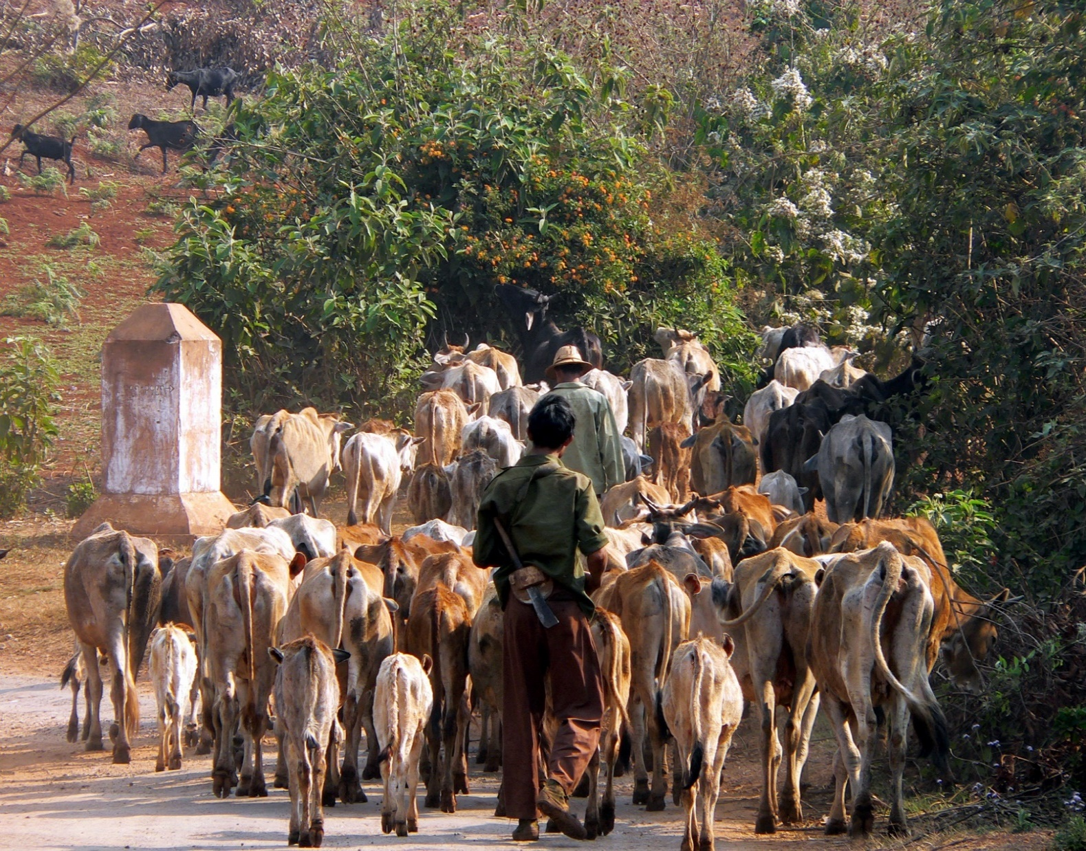
Myanmar Investment Law (MIL), 2016
11
MIL was enacted in 2016 by combining the Foreign Investment Law, 2012 and Myanmar Citizens Investment Law, 2013
The government separately passed implementing rules (Myanmar Investment Rules) on 30 March 2017
MFL introduced two categories of investment approval procedures, one is a MIC permit and the other is an investment endorsement
MIC permit is mandatory for the investment activities that are necessary to obtain MIC permit
MIC endorsement is optional and it can be applied by those who wish to enjoy benefits including tax exemptions and long-term use of land
Under the MIL foreign investors can benefit from significant tax exemptions and other benefits
Myanmar Investment Commission (MIC) established
Directorate of Investment and Company Administration (DICA) serves as the Secretariat of MIC
The MIL applies to three forms of foreign investment
100% foreign owned companies
Joint ventures with a local investor or a government department or organization
Investments carried out through contractual relationships with local investors

Slide 12

12
MIL: Objectives
Infrastructure development (various professional fields)
Development of high functioning production, service and trading sectors
Employment creation
Environmental protection
Development of technology and the agriculture, livestock and industrial sectors
Development of businesses and investments that meet international standards

Slide 13

13
MIL: Incentives
Guarantee against expropriation/nationalization
Guaranteed remittance of profits; remittance upon exiting the investment
Equity in an MIL company can be transferred with the approval of the MIC
Foreigners are permitted to lease land for up to 50 years as well as two continuous extensions of 10 years if approved by the MIC
MIL allows promoted investment sectors to enjoy corporate income tax holidays depending on the type of development zone specified under Notification No. 10/2017 of MIC

Slide 14

14
MIL: Tax Incentives
Corporate income tax holidays for a period from three to seven consecutive years depending on the zones specified by MIL
Tax exemptions or relief for capital assets imported and used in the business during the construction period
Tax exemptions or relief for the importation of raw materials and partially manufactured goods
Tax reimbursement for the importation of raw materials and partially manufactured goods
Tax exemptions for re-invested profits
Right to deduct depreciation on capital assets
Tax deductions for research and development

Slide 15

15
MIL: MIC Notifications
Three prominent Notifications of MIC issued under MIL :-
Notification 10/2017 sets out the designation of the development zones by specifying less developed regions as zone 1, moderate developed regions as zone 2 and developed regions as zone 3 for the purpose of income tax exemption and relief.
Notification 13/2017 sets out the classification of promoted sectors which shall be granted income tax exemptions if it is apply to MIC.
Notification 15/2013 sets out various regulations and procedural information in relation to investment licences

Slide 16

16
MIL: Promoted Sectors
Under Notification 13/2017 of MIC, the following types of business are classified as being a promoted sector:
Agriculture and its related services (except cultivation and production of tobacco and virginia)
Plantation and conservation of forest, and other businesses with forests
Livestock production, breeding and production of fishery products, and its related services
Manufacturing (except manufacturing of cigarette, liqueur, beer, and other harmful products to health)
Establishment of industrial zones
Establishment of new urban areas

Slide 17

MIL: Promoted Sectors (cont’d)
17
City development activities
Construction of road, bridge and railway line
Construction of seaport, river port and dry port
Management, operation and maintenance of airport
Maintenance of aircrafts
Supply and transport services
Power generation, transmission and distribution
Production of renewable energy
Telecommunication businesses
Education services
Health services
Information technology services
Hotel and tourism
Science research development business
The investments covered in the above investment promoted sectors shall be granted income tax exemptions if it applies to MIC.

Slide 18

18
MIL: List of Restricted Investment Activities
Notification 15/2017 of MIC divides investment activities into four categories. These are:-
Investment activities allowed to be carried out only by the Union
Investment activities that are not allowed to be carried out by foreign investors
Investment activities allowed only in the form of a joint venture with any citizen owned entity or any Myanmar citizen (Local partner or Myanmar citizen must invest and hold a minimum of 20% in the form of a joint venture)
Investment activities to be carried out with the approval of the relevant ministries

Slide 19
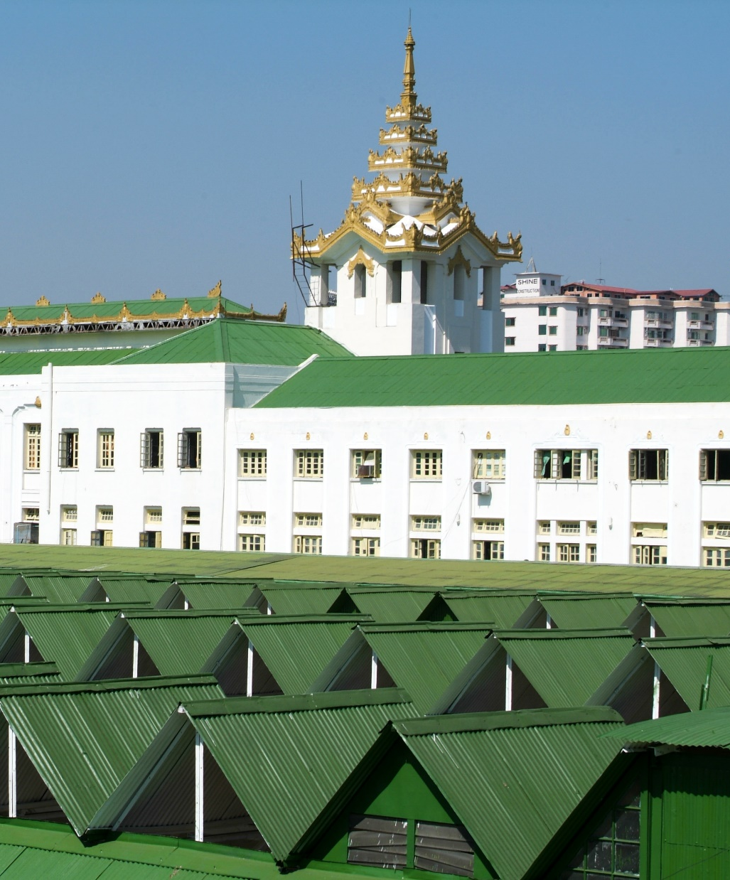
19
Designated insurance businesses to be insured
The investor who obtained an MIC permit or tax exemption or relief for the following insurance business types must insure in line with Notification No. 76/2018 which was amended by the Myanmar Investment Rules.
Property and Business Interruption Insurance;
Engineering Insurance;
Professional Liability Insurance;
Bodily Injury Insurance;
Marine Insurance; or
Workmen Compensation Insurance;
Life Insurance; and
Fire Insurance

Slide 20

20
Investment in the Education Sector
The MIC published the Notification No. 7/2018 regulating local and foreign investment activities in the education sector. The investors who need to carry out the investments in the following types of education services in the form of private schools with the permission of the MIC.
Private basic education school;
Private technical, vocational and training school;
Private higher education school;
Private subject based school; and
Private school designated by the Ministry.

Slide 21

21
About Myanmar Investment Commission (MIC)
The Myanmar Investment Commission (MIC) is a government-appointed body which is responsible for verifying and approving investment proposals, and regularly issues notifications about sector-specific developments. The Myanmar Investment Law changes the role of the MIC - with fewer investment proposals now requiring formal MIC approval. A new Endorsement process - whereby proposals are fast-tracked by being ‘endorsed’ by the MIC - is now also available to investors. The MIC is comprised of representatives and experts from government ministries, departments, and governmental and non-governmental bodies.

Slide 22

22
Myanmar Investment Commission (MIC) (cont’d)
Objectives of the MIC include:
To protect investors according to the new investment law promulgated by Union Hluttaw (Parliament)
To safeguard environmental conservation
To deeply emphasise social impact
To practice accounting and auditing in accordance with international standards in financial matters - including transparency and accountability
To create job opportunities
To abide by existing labour laws
To support corporate social responsibility
To transfer technology

Slide 23
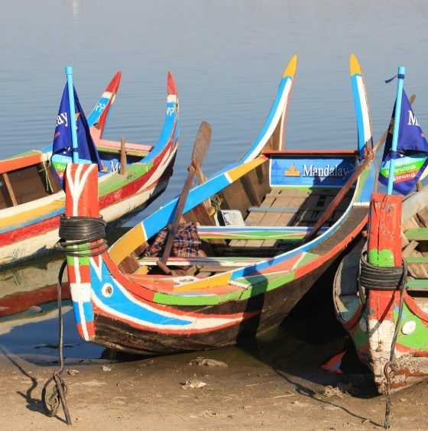



23
Investment Procedures: MIC Permit and Investment Endorsement
MIL introduces two categories of investment approval procedures, one is a MIC permit and the other one is an investment endorsement. These are generally referred to as MIC Permit Procedure and Investment Endorsement Procedure. The introduction of investment endorsement procedure has significantly simplified and eased the investment procedures in Myanmar. It is impossible to apply for both a MIC permit and an endorsement.

Slide 24

Investment Procedures (cont’d)
24
MIC Permit
Before MIL, any investor had to submit a proposal to the MIC for a permit, regardless of the business size if they intend to benefit from the MIC incentives.
According to MIL, far fewer proposals will be screened and permitted by MIC. Investors shall submit a proposal to the MIC and invest after receiving the permit for the following investment activities stipulated in Myanmar Investment Rules:
Investment activities that are essential to the national strategy;
Large capital intensive investment projects;
Projects which are likely to cause a large impact on the environment and the local community;

Slide 25

25
Investment Procedures (cont’d)
Investment activities which use state owned land and buildings; or
Investment activities which are designated by the Government to require the submission of a proposal to MIC.

Slide 26



MIC Application Process
26
Step 1
Prepare for investment application
REQUIREMENTS:
Draft land lease agreement
NECESSARY PAYMENTS:
5,000 kyats
Lease land from government body or private land owner
Seek advice and information from Ministry Information Desk at OSSC/DICA
Buy Investment Proposal Form from DICA Admin Division
Step 2
Apply for investment permit
REQUIREMENTS:
Necessary documents and lease agreement
Fill in the investment proposal form and prepare necessary documents indicated in the checklist
Submit application documents to DICA Investment Division

Slide 27






MIC Application Process (cont’d)
27
Step 3
Review of investment application
Attend the meeting of PAT (Proposal Assessment Team) and make a briefing on the project and clarify any queries, questions from PAT
Receive acceptance letter from PAT and revise necessary changes (if needed)
Step 4
Finalizing
REQUIREMENTS:
See information on EMP, EIA and IEE
Implement EMP or negotiate EIP/SIA or IEE
Attend the MIC Meeting and present on the investment proposal
Receive MIC Permit or letter of rejection
Source: Myanmar Investment Commission

Slide 28


28
Investment Endorsement
If investment activities are not in the category of investment activities which require a MIC permit as described in the above-mentioned activities, the investors are not required to submit a permit proposal to MIC.
However, in order to enjoy long-term land use right, tax exemptions and reliefs described in MIL, the investors may undergo an investment endorsement application process.

Slide 29
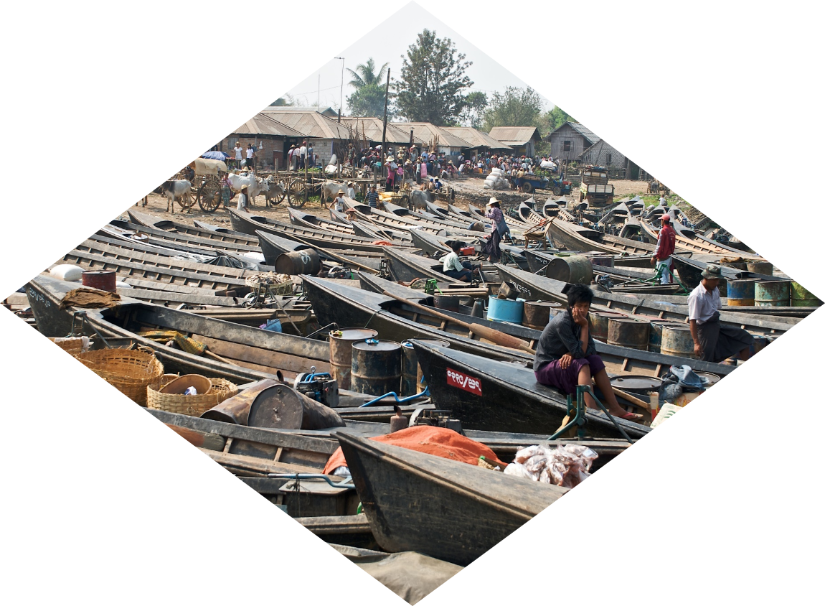




29
Endorsement Application Process
STAGE 1
COLLECT INFORMATION FROM DICA
Seek advice and details from DICA
STAGE 2
PREPARE DOCUMENTS
Buy and Endorsement Application Form, complete it and submit it to the MIC or the State and Regional Investment Committee
STAGE 3
ASSESSING THE APPLICATION PACKAGE
Review by MIC or the State and Regional Investment Committee
STAGE 4
OBTAINING RESULTS
Collect the Endorsement if MIC or the State and Regional Investment Committee accepts the application
Source: Myanmar Investment Commission

Slide 30

30
Myanmar Companies Law (MCL), 2017
The MCL removes the requirement for foreign companies to hold a separate “permit to trade”, significantly reducing another regulatory burden and levelling the playing field.
According to new Myanmar Companies Law (MCL), there is no restriction on conducting any business activities including trading business for foreign companies. They can conduct any business activities as long as they are in compliance with the law and have the requisite permits and licenses.

Slide 31

Myanmar Companies Law (MCL), 2017 (cont’d)
31
The MCL allows non-Myanmar investors to have up to a 35% stake in a local business, before it is categorized as a foreign company.
This encourages domestic businesses to seek overseas expertise and capital via joint-ventures. In addition, the law has opened-up the Yangon Stock Exchange for foreign customers.
For private companies being set-up, only one director and one shareholder is required. The sole director can also be the sole shareholder of a private company. Therefore, a single person can now register a company in Myanmar.

Slide 32

32
Myanmar Companies Law (MCL), 2017 (cont’d)
Public companies require three or more Directors.
Directors must carry out their duties in such manner as to ensure that the company is properly managed in the best interests of their stakeholders and shareholders.

Slide 33

Types of companies and entities
33
The following companies and entities which can be registered under the MCL are:
Private Company Limited by Shares
Public Company Limited by Shares
Company Limited by Guarantee
Unlimited Company
Business Association
Public Company Limited by Shares (under the Special Company Act 1950)
Private Company Limited by Shares (under the Special Company Act 1950)
Overseas Corporation

Slide 34

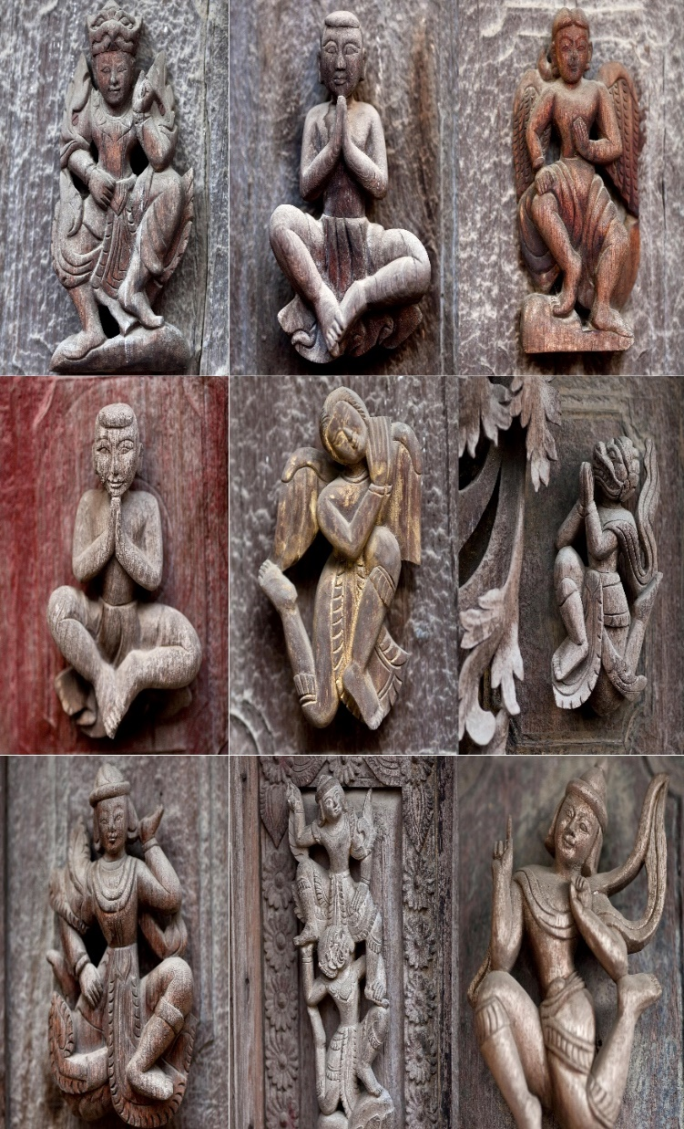
34
Main Types of Companies
Company Limited by Shares: In a company limited by shares, the liability of shareholders is limited to the amount unpaid on their shares. A company limited by shares is the most common type of company used in Myanmar and in international business.
Company Limited by Guarantee: In a company limited by guarantee, the liability of members is limited to the amount that the member undertakes to contribute if the company is liquidated and there are insufficient assets to pay any outstanding debts. The sum guaranteed by member is usually specified in the company’s constitution.
Unlimited Company: An unlimited company does not have any limit on the liability of its members. Therefore, members have an obligation to meet any outstanding financial liability of the company which cannot be repaid from its asset in the event of liquidation. This type of company is much less commonly used.

Slide 35

Requirements for Directors
35
Under the MCL, a private company must have at least one director and a public company must have at least three directors. At least one director of every company must be ordinary resident in Myanmar. The ordinary resident director may be a permanent resident of Myanmar or be resident in the country for at least 183 days in every 12-month period.
The MCL sets out the minimum qualifications for directors of companies:
a director must be a natural person who is at least 18 years old;
a director must be of sound mind;
a director must not be a person who has been disqualified from acting as a director under the MCL or any other applicable law; and
a director must not be an undischarged bankrupt.
A company may set out additional qualifications of directors in the company constitution such as a requirement to hold shares in the company.

Slide 36
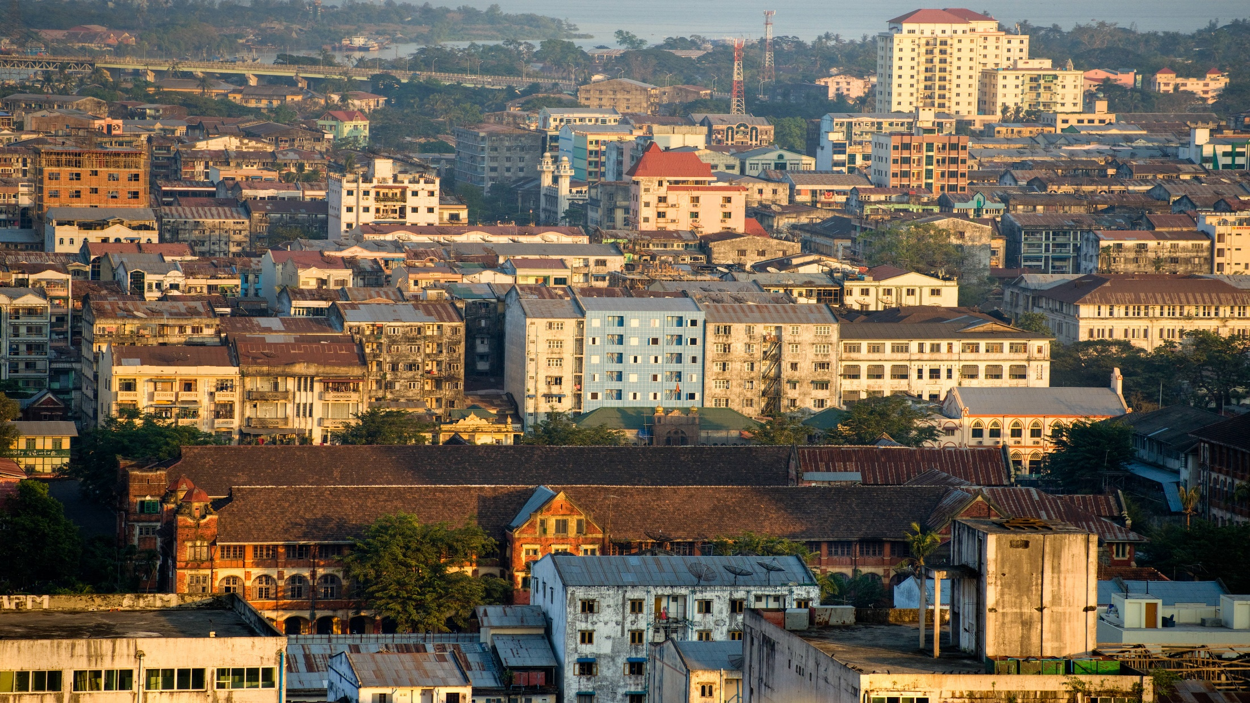
36
MCL: Some Distinct Changes
Single Director and Single Shareholder Company
Under MCL, a private company can be established with at least one shareholder and one director who ordinarily reside in Myanmar. The sole director can also be the sole shareholder of a private company. Therefore, a single person can now register a company in Myanmar.
What is Company Constitution?
According to MCL, Memorandum of Association and Articles of Association (MOA & AOA) are replaced by a single document, the company constitution, and the requirement to have objects has been removed. The company constitution is an important document which sets out the rules for how the company is governed, including the rights and obligations of shareholders. It has legal effect as a contract between the company and its shareholders and is legally binding on all shareholders.

Slide 37

37
MCL: Some Distinct Changes (cont’d)
Ownership Ratio
The MCL allows foreigners or foreign companies to obtain up to 35% equity in a Myanmar company and this company will still be categorized as a Myanmar company. If the threshold of 35% is exceeded, the company will be categorised as a foreign company.

Slide 38

38
MCL: Overseas Corporation
Foreign companies that carry on business in Myanmar may have to be registered as an overseas corporation with the Directorate of Investment and Company Administration (DICA). Otherwise, an overseas corporation is basically a Myanmar branch of a company that has been incorporated outside Myanmar.
In the case of registration of an overseas corporation - section 47(b) (ix) of the MCL provides that the application must be accompanied by evidence of incorporation of the overseas corporation and a copy of the instrument constituting or defining the constitution of the corporation, and, if not in Myanmar language, a Myanmar language translation of such documents and a summary statement in the English language (if the original is not in English language) duly certified by a director.

Slide 39
39
MCL: Overseas Corporation (cont’d)
A. Evidence of incorporation: Submit a Certificate of Incorporation, a Certified Extract, a Certificate of Good Standing or equivalent document from the registrar of corporations in its jurisdiction of incorporation dated no more than thirty (30) days before the date of submission of the application.
B. Constitution: The overseas corporation must include a copy of its Constitution (or equivalent), a Myanmar language translation of such document and a summary statement in the English language (if the original is not in English language) duly certified by a director.

Slide 40

Myanmar Companies Online (MyCO) Registry
40
The MyCO registry is established and maintained by DICA as a public registry of all companies and entites registered under MCL. The information on the MyCO registry is maintained electronically and is publicly accessible 24 hours a day.
All forms and documents required to be filed with the Registrar under MCL can be submitted by a representative of the company or a third party on behalf of the company in the following ways:
Online on the MyCO registry at www.myco.dica.gov.mm; or
In person at a DICA office to be uploaded electronically on the MyCO registry.
Directors of a company (or the company secretary if the company has appointed one) are legally responsible for filing documents and for the accuracy of the information filed with the Registrar. Directors are also legally responsible even if they have appointed a third party (such as an accountant, agent or lawyer) to lodge documents on behalf of the company.
Source: Directorate of Investment and Company Administration (DICA)

Slide 41

41
41
41
Share Capital Requirement
There is no minimum capital requirement when registering a company in Myanmar. For details pertaining to the minimum requirement for banking, Insurance, securities and trading companies, reference should be had to the Central Bank of Myanmar, and Ministry of Planning and Finance and Ministry of Commerce.

Slide 42
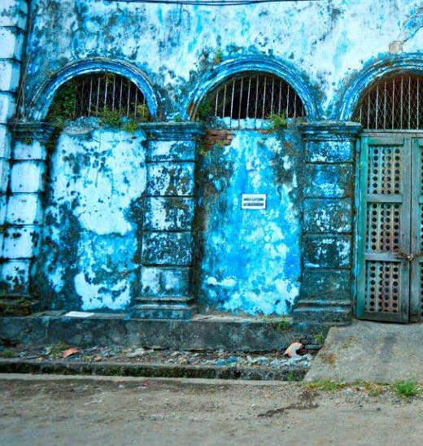
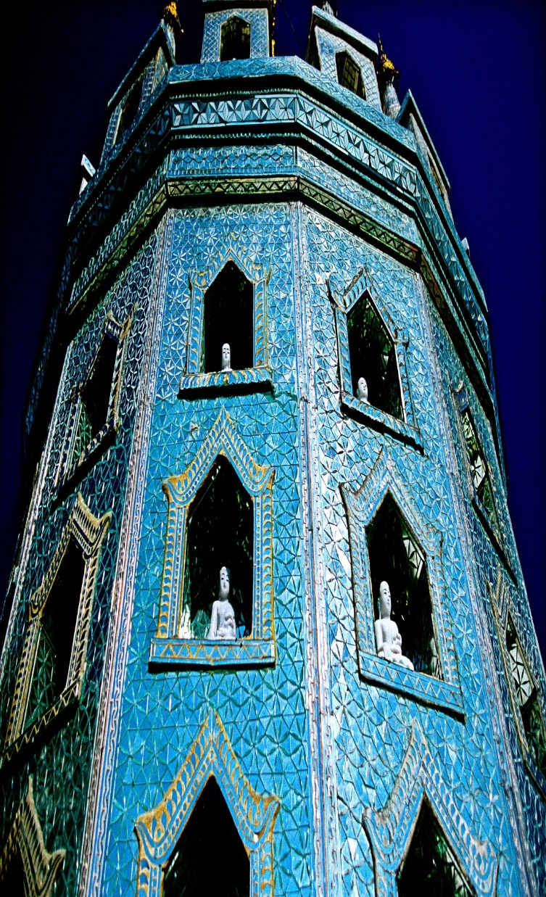
Wholesale and Retail Trading Business
42
Registration and permits
Pursuant to the Myanmar Ministry of Commerce Notification No. 25/2018 dated 9 May 2018, wholly foreign-owned companies and joint ventures with foreign shareholdings are permitted to engage in retail and wholesale trading (of domestically produced and/or imported goods) in Myanmar, subject to compliance with certain requirements and investment criteria.
All wholly foreign-owned companies and joint ventures with foreign shareholdings are required to register with the Ministry of Commerce, and obtain a permit before they can engage in trading activities. The following documents and information must be submitted to the Ministry of Commerce for purposes of registration:

Slide 43
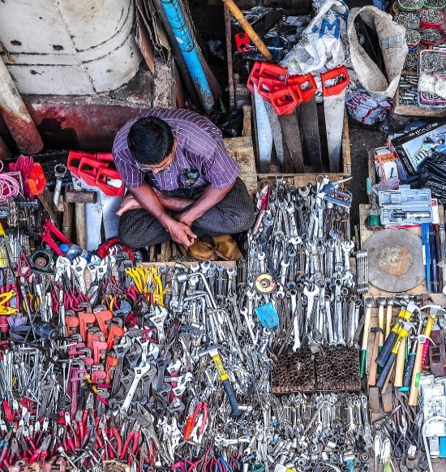



Wholesale and Retail Trading Business (cont’d)
43
certification of incorporation;
copy of Myanmar Investment Commission (MIC) permit or MIC endorsement (where applicable);
recommendation letter from the relevant City Development Committee or Township Development Committee in each region or state in which the company proposes to trade;
list of goods proposed to be traded; and
detailed business plan (including the initial investment amount, the proposed trading location(s), area of land use and proposed trade volumes).

Slide 44


Taxes
44
Corporate Tax (Profit Tax)
A company that is incorporated in Myanmar and established under the Myanmar Companies Law and Special Company Act 1950 and businesses that receive approval from Myanmar Investment Commission have their income taxed at a rate of 25%.
Salaries Tax
Myanmar residents are subject to tax on their worldwide income subject only to a few exceptions. Taxable income includes salaries income. Myanmar has a progressive tax rate from 0% - 25% which applies to income received from salary, property, business and others.
Nonresident foreigners are charged tax on their salary income at rates which range from 0% - 25% before any exemptions are applied.

Slide 45
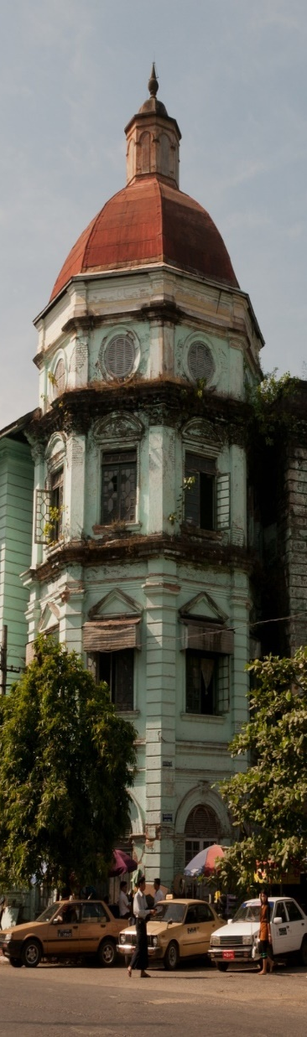
Taxes (cont’d)
45
Commercial Tax
Commercial tax is payable on goods that are imported or produced in Myanmar, as well as trading sales and services. The commercial tax levied on the export of electricity is at a rate of 8% and crude oil at a rate of 5%. Commercial tax does not apply to the rest of the sales of exported products.
Specific Goods Tax
The Specific Goods Tax Law replaces commercial tax on a list of specific goods that are imported into Myanmar, manufactured in Myanmar, or exported to a foreign country. The list of specific goods include cigarettes, tobacco leaves, virginia leaves, cheroots, cigars, pipe tobaccos, and betel-chewing tobacco; beers, wine, and alcoholic beverages; wood logs and wood cuttings; vans, saloons, sedans and estate wagons, and coupe cars except double cab 4-door pickups from the range of 1501 cc to 4001 cc and above; and kerosene, petrol, diesel, and aviation jet fuel, as well as natural gas. The specific goods tax rates range from 5% to 60%.

Slide 46

Taxes (cont’d)
46
Gems Tax
Under the UTL 2019, with effect from 1 October 2019, gemstones, whether it is rough or cut or jewellery or things made with gemstones, shall be subject to gems tax (as opposed to specific goods tax) in accordance with section 38 of the Myanmar Gemstone Law 2019. The tax rates are range from 5% to 11%.

Slide 47

47
Taxes (cont’d)
Stamp Duties
Stamp duty is levied on various types of instruments including but not limited to, the following instruments:
2% of the amount or value of the consideration for conveyances of properties, for the sale or transfer of immovable property. Immovable properties located in Nay Pyi Taw, Yangon, and Mandalay are subject to an additional 2% of stamp duty on the consideration equal to the market value of the properties.
0.1% of share value on the transfer of shares.
0.5% of the amount or value secured on bonds.
0.5% of the annual value of rent for immovable properties on lease agreements ranging between one and three years, and 2% of the average annual value of rent where the term of the lease agreement is more than three years. 2% stamp duty will also be applicable on lease premium.

Slide 48

48
Taxes (cont’d)
Capital Gains Taxes
Capital gains tax is levied on gains from the sale, exchange, or transfer of capital assets (i.e. any land, building, vehicle, and any capital assets of an enterprise, which include shares, bonds, and similar instruments).
Capital gains from the sale, exchange, or transfer of capital assets in the oil and gas sector (companies engaged in upstream oil and gas activities relating to exploration, drilling, and extraction) are taxed at different rates from those in other sectors.

Slide 49

Taxes (cont’d)
49
Type of taxpayer | Tax rate (%)
Resident companies | 10
Non-resident companies | 10
Transfer of shares in companies engaged in upstream oil and gas activities relating to exploration, drilling, and extraction or interest in production sharing contracts | 40 to 50
Tax returns for capital gains must be filed within 30 days from the date of disposal of the capital assets. Capital gains tax payments are required to be made within 30 days from the date of disposal of the capital assets. The date of disposal refers to the date of execution of the deed of disposal or the date of delivery of the capital assets, whichever is earlier.

Slide 50

50
Property
Generally, foreigners not permitted to own property in Myanmar
Foreigners may own up to 40% of the total units of a condominium building under the Condominium Law
MIC must consent to foreigners leasing land
MIC has the right to require the lease to be terminated in certain circumstances i.e. failure to pay rent or environmental damage
Foreigners cannot enter into leases for land that are in excess of 50 years. MIC can agree to an extension of the term by two periods of 10 years, i.e. to a total of 70 years
Leases of immovable property require registration if they last over one year or have yearly rent
Leases are not granted for religious land; land restricted for state security; land under litigation; and land restricted by the state

Slide 51

51
Property (cont’d)
At present demand for modern commercial and residential property in Yangon is strong whereas supply is limited
Mortgage market yet to develop
Yangon’s housing stock comprised primarily of apartments / condominiums
Design and build quality of many condominiums/apartments remains poor
Complimentary infrastructure/amenities also remain underdeveloped
Opportunities exist to develop modern serviced apartments and commercial centers and tourist/hospitality orientated real estate projects

Slide 52


52
Special Economic Zones Law (SEZs)
The Special Economic Zone Law was enacted in 2014, and its implementing Rules were published in 2015. The law has paved the way for Special Economic Zones (SEZs) in Myanmar.
There are currently three SEZs in development: Kyauk Phyu in Rakhine State, Dawei in the Thanintharyi Region and the Thilawa in Yangon Region. In order to carry out their implementation, the Central Body, Central Working Body and Management Committee was formed under the SEZ Law.

Slide 53

53
Special Economic Zones Law (SEZs) (cont’d)
SEZs: Investment opportunities
Infrastructure development
    Roads construction
    Bridge construction
    Airport construction
    Port construction
    Electricity production
    Telecommunications infrastructure development
    Water supply production
    Environmental conservation
    Waste control systems

Slide 54

Special Economic Zones Law (SEZs) (cont’d)
54
Production based industries
    Goods processing
    Hi-tech goods manufacturing
    Agriculture
    Livestock breeding and fisheries
    Mineral produce
    Forestry produce
Services based industries
    Trade
    Logistics and transport
    Storage and warehousing
    Hotels and tourism
    Education and health
    Residential facilities
    Infrastructure supply and support centers
    Green spaces
    Recreation centers and resorts

Slide 55




SEZs: Incentives
55
The Myanmar Special Economic Zones Law (No. 1/2014) was passed in January 2014 and stipulates the following tax incentives for investors in SEZs:
Income tax exemption for the first seven years from the date commercial operations commence within an exempted zone or an exempted business
Income tax exemption for the first five years from the date commercial operations commence for businesses located within a promoted zone or a SEZ
50% income tax reduction for the second five year period for businesses within an exempted or promoted zone
50% income tax reduction for the third five year period on profits derived from the reinvestment of a business that is within an exempted or promoted zone (subject to conditions)
Import duty exemption on the importation of raw materials, machinery, equipment and other specific goods which are used for prescribed activities in an exempted zone
Import duty exemption or 50% reduction for up to five years on raw materials, machinery and equipment that is imported by a business located within a promoted zone
Losses carried forward for five years from the date the loss was incurred

Slide 56
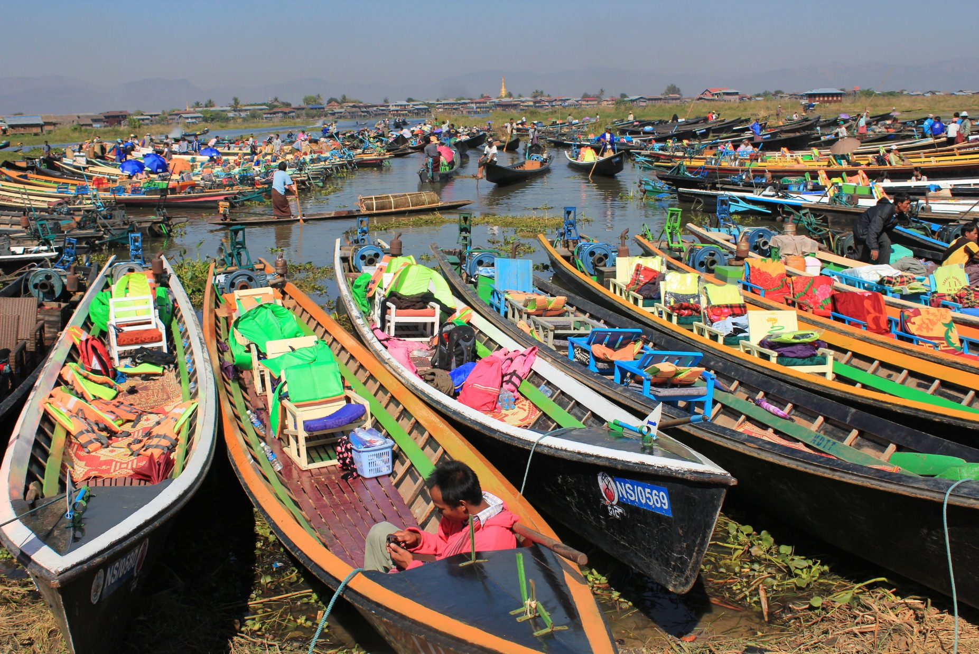
Right to transfer foreign currency
56
According to Section 56 of the MIL, foreign investors may transfer the following funds abroad relating to the investments made under this Law:
capital designated under the provisions relating to capital account rules stipulated by the Central Bank of Myanmar;
proceeds, profits from the asset, dividends, royalties, patent fees, license fees, technical assistance and management fees, shares and other current income resulting from any investment under this Law;
proceeds from the total or partial sale or liquidation of an investment;
payments made under a contract, including a loan agreement;
payments resulting from any settlement of investment disputes;
other compensation or money as compensation under the investment or expropriation;
remuneration, salary and earnings of foreign experts legally employed in the Union of Myanmar

Slide 57

57
57
Employment Issues
No consolidated employment law – numerous acts containing provisions relating to employment and workers’ rights
Minimum wage stipulated by minimum wage committee
Only Myanmar citizens must be appointed for works which do not require skills
Skilled citizen and foreign workers, technicians, and staff shall be appointed by signing an employment contract between employer and employee in accordance with the labour laws and rules

Slide 58

Employment Issues (cont’d)
58
The entitlements and rights in the labour laws and rules, including minimum wages and salary, leave, holiday, overtime fee, damages, compensation of the workman, social welfare, and other insurance relating to workers in stipulating the rights and duties of employers and employees and occupational terms and conditions should be stipulated in the employment contract
The disputes arising among employers, among workers, between employers and workers, and technicians or staff shall be settled in accordance with the applicable laws.

Slide 59

Corporate Matters
59
Directors
The minimum number of directors of a private company and a public company in Myanmar is one and three respectively.
The MCL requires a return of particulars of directors, managers and managing agents and any changes of such particulars to be lodged with the DICA no later than 21 days after the relevant appointment or changes
Directors can be foreign or local
Meetings of Shareholders (General Meetings)
General meetings of a company are called to present matters for approval by shareholders (by passing shareholder resolutions). Shareholders have a right to receive notices of meetings. At least 21 days’ advance notice must be given for general meetings for private companies and 28 days’ advance notice must be given for general meetings for public companies.
Company directors have the power to call general meetings. Shareholders who hold at least 10% of the issued shares of the company may also request the directors to call and hold a general meeting.

Slide 60

Corporate Matters (cont’d)
60
There are three types of meetings of shareholders under MCL:
An annual general meeting (AGM) which must be held 18 months from the date of incorporation and once every calendar year. At the AGM, the usual proceedings include election of directors of the company (by shareholders) and if a company is required to prepare an annual financial report, directors’ report and auditor’s report, they must also be presented to the shareholders at the AGM.
A special general meeting which is any other meeting of the members of a company (other than an AGM).
A statutory meeting which only public companies and companies limited by guarantee with share capital are required to call within 6 months and less than 28 days from the date of incorporation.

Slide 61

Accounting Standards
61
Accounting standards in Myanmar are set by the Myanmar Accountancy Council which is headed by the Union Auditor General of the Republic of the Union of Myanmar
On 5 June 2010, Myanmar Financial Reporting Standards were introduced. These are identical to the International Financial Reporting Standards (IFRS) that existed on that date
Commitment made to formally adopt IFRS standards
Accounting and audit services can be provided legally by 100% Myanmar owned firms as well as JV companies and foreign companies.
Fiscal year in Myanmar is 1 April to 31 March

Slide 62

62
Foreign Participation in Stock Exchange
Started from 20th March 2020, foreign investors are allowed to participate in Myanmar stock market in line with Notification no. 1/2019 and Instruction no. 1/2020 of the Securities and Exchange Commission in Myanmar (SECM).
It follows the legislation of Myanmar Companies Law in 2017 and Myanmar Investment Law giving equal investment opportunities for all foreigners except for in some regulated industries.
Myanmar securities market is still in its initial stage of growth and investment opportunities are expected to grow gradually.

Slide 63

63
Foreign Participation in Stock Exchange (cont’d)
Foreign investors who need to participate in listed companies must open the following bank accounts for securities trading in Myanmar at one of the banks operating in Myanmar:
  Resident individuals/institutions: Resident Kyat Account for Securities (R-KAS)
  Nonresident individuals/institutions: Nonresident Kyat Account for Securities (N-KAS) and Nonresident Foreign currency Account for Securities (N-FAS)
Investors who are considering the Myanmar Capital Market can buy securities from –
  the government which is issuing through the Central Bank of Myanmar treasury bonds; and
  public companies where shares can be traded on the YSX if they are publicly listed.

Slide 64




64
Legislation on Intellectual Property Rights
Although IP Laws such as trademark, copyright, patents and industrial design Laws in Myanmar were drafted in 2014 and have been passed, they laws have yet to be enacted. These laws will come into effect by notification of the president.
Presently, investors will need to rely on the current laws for protection. For instance, companies may register a trademark by means of Declaration at the Registry Office, which is accepted as evidence of ownership of a mark. Further, the Competition Law 2015 outlaws unfair competition, including disclosure of business secrets, such as protected business information and business procedures without the owner’s consent.

Slide 65


Managing Partner
65
Julia Charlton
Julia, LL.B (1st class Honours), A.K.C (Kings College, London) was admitted as a solicitor in England & Wales in 1985 and has practiced as a solicitor in Hong Kong since 1987
Julia holds a number of professional positions, including:
Member of the Hong Kong Takeovers Panel and the Takeovers Appeal Panel of the SFC; Member of the Disciplinary Panel (Panel A) of the Hong Kong Institute of Certified Public Accountants (often acting as Chair in relation to disciplinary cases); and Member of the Company Law Committee of the Hong Kong Law Society.
Julia was named a “Leading Lawyer” by Asia Law & Practice for the years 2002 -2018
Julia has extensive experience in China and Myanmar work and is a Mandarin speaker

Slide 66
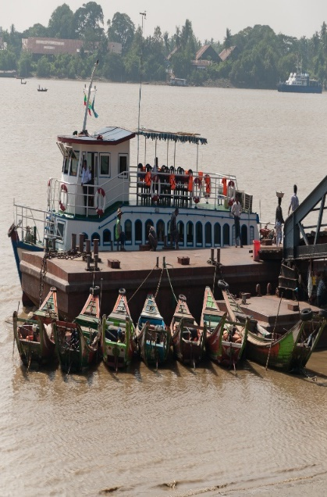

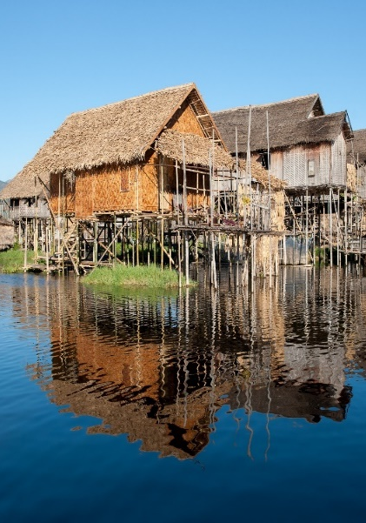
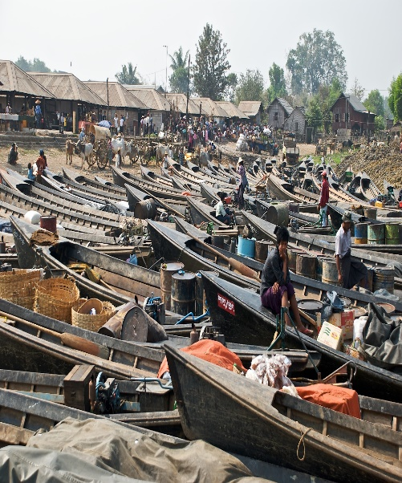
66
66
66
Contact us
Hong Kong Office
12th Floor Dominion Centre
43 – 59 Queen’s Road East
Hong Kong
Telephone: Fax:
Email: Website:
(852) 2905 7888
(852) 2854 9596
enquiries@charltonslaw.com
www.charltonslaw.com

Slide 67

67
Other locations
China
Beijing Representative Office
3-1703, Vantone Centre A6# Chaowai Avenue Chaoyang District Beijing People's Republic of China
Shanghai Representative Office
Room 2006, 20th Floor Fortune Times
1438 North Shanxi Road
Shanghai People's Republic of China
Telephone: (86) 10 5907 3299
Facsimile: (86) 10 5907 3299 enquiries.beijing@charltonslaw.com
Telephone: (86) 21 6277 9899
Facsimile: (86) 21 6277 7899 enquiries.shanghai@charltonslaw.com
Myanmar
Yangon Office of Charltons Legal Consulting Ltd
161, 50th Street Yangon Myanmar
Telephone: (95) 1 8203898
enquiries.myanmar@charltonslaw.com
www.charltonsmyanmar.com

